Slide 1
Amazon Food Review
Presented by-
Ganesh M Hegde 1ms12cs033
Charan Rao S 1ms13cs406
Karthik M 1ms13cs407
Mithun R 1ms13cs414

Slide 2
PROJECT GOALS
The Goal of this project is to find out which food is being praised or criticized by the customer through review in one of the major Food sites like Amazon.
Recommending products to consumers means not only understanding their tastes, but also understanding their level of experience.
Then the total number of customer’s review Will be analyzed by sampling and then final outcome like is the product best to use or not? Will be produced at the end

Slide 3
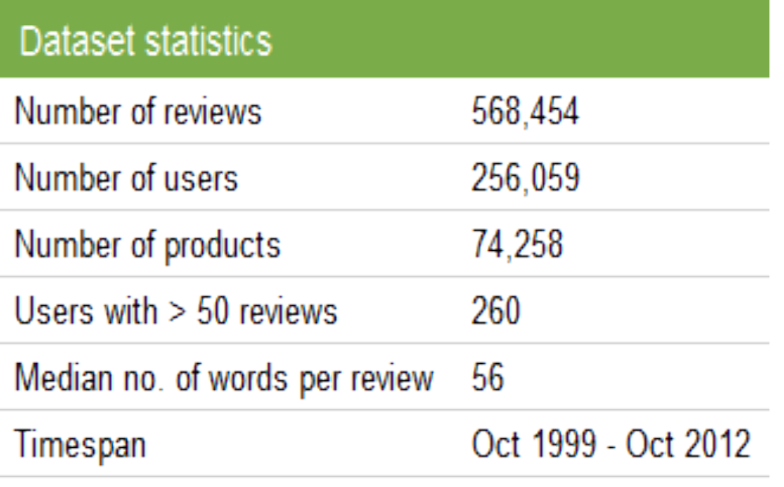
DATA SET DESCRIPTION
This dataset consists of reviews of fine foods from Amazon.

Slide 4
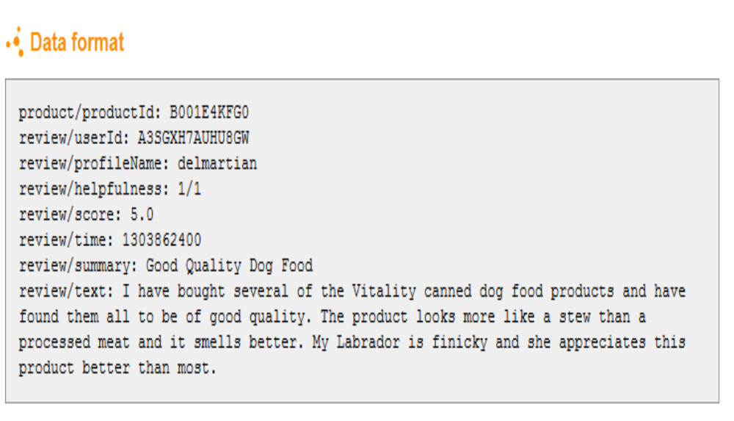
DATA SET DESCRIPTION

Slide 5
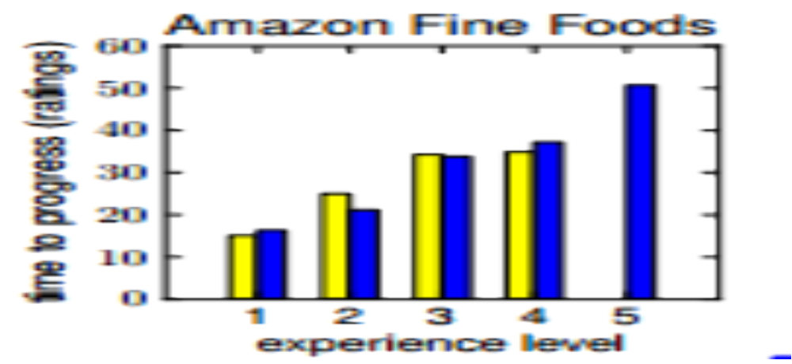

Slide 6
DESCRIPTION ABOUT THE SRS
The SRS document enlists enough and necessary requirements that are required for the project development or analysis.
SRS helps in better understanding of the project by specifying the functional requirements, software system attributes etc.
It minimizes the time and effort required to analyse the data as the requirement are specified.
It also specifies system and hardware requirements.

Slide 7
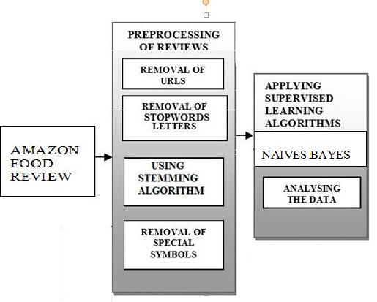
DESCRIPTION OF THE DESIGN

Slide 8
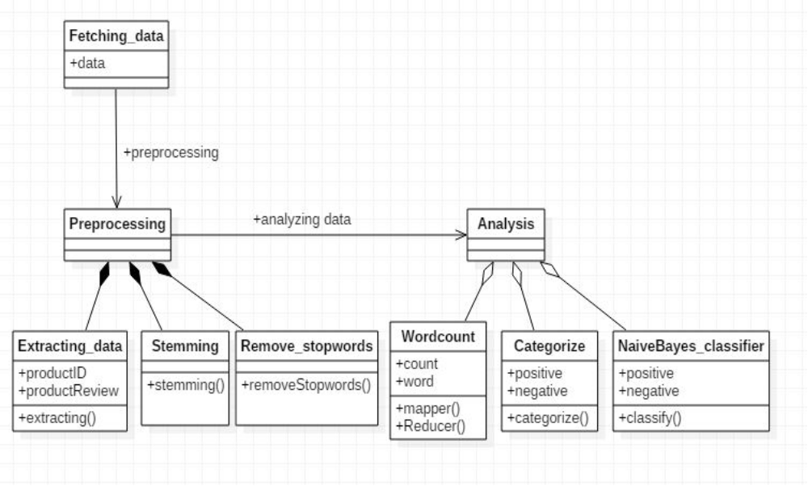
Class Diagram

Slide 9
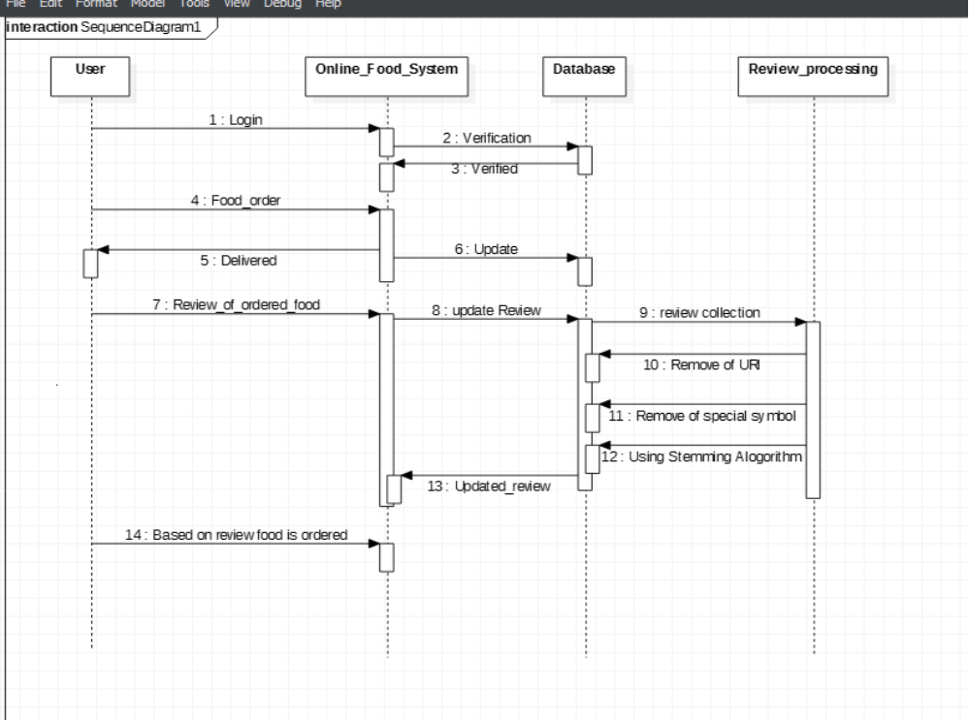
Sequence Diagram

Slide 10
Implementation
Sentiment Analysis module
Entity Analysis module
Filter Module

Slide 11
Porter’s Algorithm (stemming)
Step 1 :Gets rid of plurals and -ed or -ing suffixes.
Step 2 :Turns terminal y to i when there is another vowel in the stem.
Step 3 :Maps double suffixes to single ones: -ization, -ational, etc.
Step 4 :Deals with suffixes, -full, -ness etc.
Step 5 :Takes off -ant, -ence, etc.

Slide 12
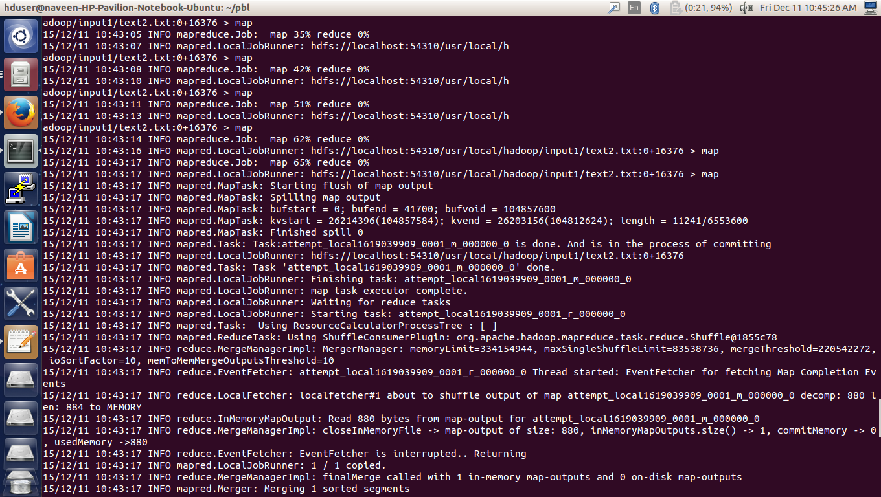
Screen Shot

Slide 13
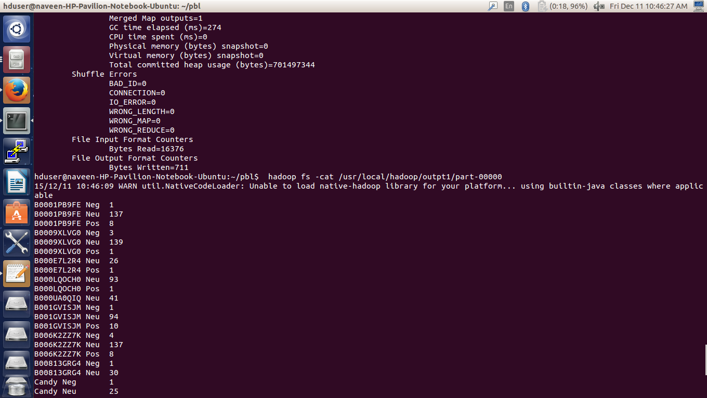

Slide 14
Scope & Future work
The scope of this project aims to satisfy the user community to make their own analysis of this classified data and also can be used for further research topic.
An interesting finding of our work is that beginners and experts have the same polarity in their opinions, but that experts give more ‘extreme’ ratings:

Slide 15
Bibliography
[1] O. Alonso, P. Devanbu, and M. Gertz. Expertise identification and visualization from CVS. In Working Conference on Mining Software Repositories, 2008.
[2] R. Bell and Y. Koren. Scalable collaborative filtering with jointly derived neighborhood interpolation weights. In ICDM, 2007.
[3] J. Bennett and S. Lanning. The Netflix prize. In KDD Cup and Workshop, 2007.
[4] L. Bergroth, H. Hakonen, and T. Raita. A survey of longest common subsequence algorithms. In SPIRE, 2000

